Slide 1



Victory with Resident
Centered/Directed Care
Charles Borst
Executive Director
Camille Miller,
President, Resident Association

Slide 2

Disclosure to Participants
Disclosure to Participants
Accreditation Statement: University of Texas at Austin School of Nursing is accredited as a provider of nursing continuing professional development by the American Nurses Credentialing Center's Commission on Accreditation.
Requirements for Successful Completion: To receive contact hours for this continuing education activity, the participant must sign in, attend the entire activity, and complete and submit the evaluation form. Once successful completion has been verified, a “Certificate of Successful Completion” will be awarded for up to 29 contact hours.
Conflicts of Interest
The activity’s Nurse Planner has determined that no one who has the ability to control the content of this CNE activity – planning committee members and presenters/authors/content reviewers – has a conflict of interest.
Joint Provider Statement: This CNE activity has been jointly provided by University of Texas at Austin School of Nursing collaboratively with University of Texas Steve Hicks School of Social Work.

Slide 3
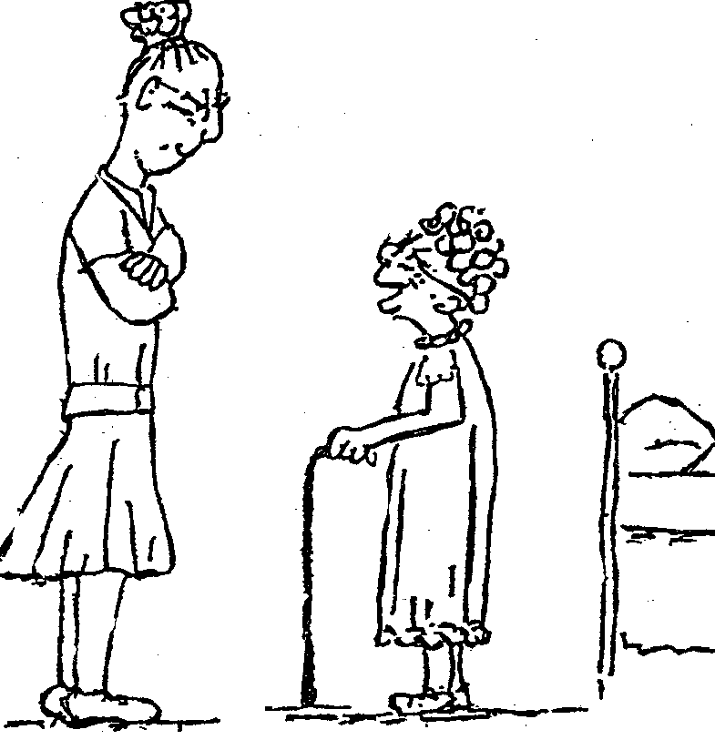
For us it all started with…
“Honey, I’ve been through two world wars, the Great Depression, taught 3,297 children, administered four elementary schools and outlived every one of the pastors I worked with. I’m 89 years old and you’re telling me it’s bedtime?”

Slide 4
What does it look like today, for us?
15 years of 5 star ratings by CMS
97% resident satisfaction
10 years Top Workplace Award
High Occupancy in every level of care
Ready/Wait list for every level of care
Great Quality Measures and Outcomes
Great Community Metrics and Finances

Slide 5
What is it?
Resident/Person Centered and Directed Care
Culture Change

Slide 6
Person-Centered Values
Know each person and anticipate their needs
Hopes, dreams, and goals are central to their care
Being included in creating their individual plan of care
Choice, dignity, respect , for the individual
Self – determination and purposeful living
Empowerment
Care centered and driven by the person receiving the care
Put person before tasks
Do unto others as you would have them do unto you
Emphasis is on relationships
Home atmosphere

Slide 7

From the Senior’s Perspective
I have the right to determine how best to meet my needs.
It must include me, my family and team in decision-making.
My care must be empowering, nurturing, and respectful.
My care should optimize my physical and psychosocial well-being.
“Nothing about me, without me.”

Slide 8

Person-centered care
is all about people – - living the lives they want to live --
in the best way they can.

Slide 9
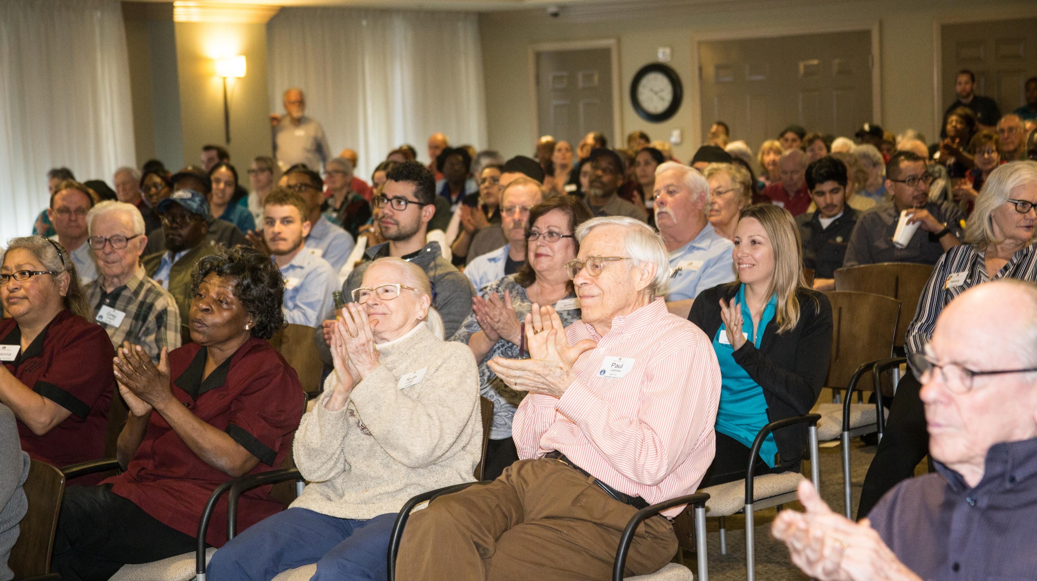
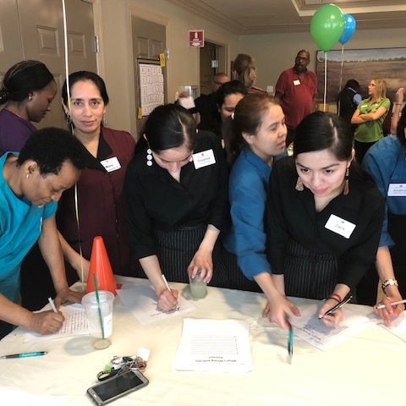
The Law of Victory:
Leaders find a way for the team to win.
From the 21 Irrefutable Laws of Leadership-
John Maxwell

Slide 10
Three Components of Victory
Unity of Vision- Teams succeed only when they share a unified vision. No matter how much talent or potential there is, there is no victory without a shared vision.
Diversity of Skills- Each person on my team contributes using his or her unique skill set, and I express my appreciation for them.
A Leader is Dedicated to Victory and Raising Members to Their Potential- It takes a leader to provide the motivation, empowerment, and direction required to win.

Slide 11
The Law of Victory
Leaders find a way for their team to win.
You must have a passion for victory.
Leaders have the right people with the right skills on their team.
Your passion to win must be higher than those on your team.
Your dedication must be unquestioned.
Your commitment to success must be higher than that of your team members.
You must Accent the Good, Punctuate the Excellent, and Dismiss the Bad.

Slide 12
Applying the Law of Victory to Your Life
Take responsibility for the success of your team or department. You lead, you control the weather. You are responsible for your teams results good or bad.
Assess your team. Write down the skills needed for your victory. Do your people have the skills necessary? Are there skills that no one has? If so, you will need to train members or add members to your team with those skills.
Is there a unity of vision? Do a little informal research, ask each team member to describe the purpose or mission of the team. If you get a diversity of answers, you should work on communicating a single vision clearly, creatively, and continually, until everyone is on the same page.

Slide 13

How can we Help All Achieve Individual Victory
Good Leaders work with each team member to show how personal goals can align with the team’s overall goals.
How can you help and support each team member in achieving their own personal victory?
Community goals and accomplishments, personal goals and accomplishments. Associate Development.

Slide 14
Winston Churchill
What is our aim? I can answer in one word: It is victory, victory at all costs, victory in spite of all terror, victory, however long and hard the road may be; for without victory there is no survival.
Unity of Vision
Diversity of Skills
Dedication to Victory

Slide 15
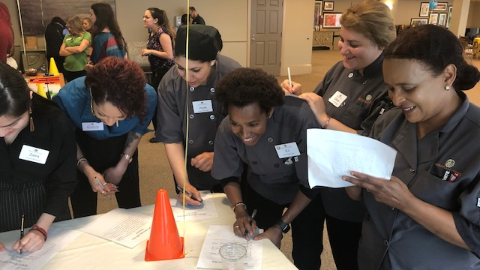
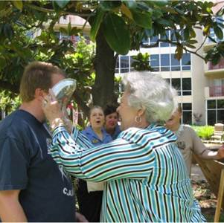
Individual Victory
How Can We Support the Individual Victory, and Achieve Victory for our Community and Those We Serve?
Person Centered Care is the Answer.

Slide 16
Culture Change/Person Directed Care
Person-centered care means that residents and associates are supported in achieving the level of success and well-being that they are capable of.
This goal honors the importance of keeping the person at the center of both the care planning and decision-making process.
In person-centered care, staff places a premium on active listening and observing, so staff can adapt to each resident’s and associates changing needs and aspirations

Slide 17
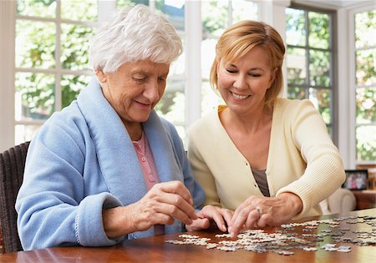
What is Person-Centered Care?
Focus on elders’ emotional needs and care preferences
Care that values the uniqueness of the individual
Maintains and/or restores personal identity
Keeps the person at the center of the care planning and decision-making process
Notes:
Shower vs Bath , Dining Times, bedtimes, activities, Medications – providing choice
This is the person’s Life and they know what they need and want to make it meaningful
Support independence

Slide 18
How Does Person-Centered Care Benefit Residents?
Residents have autonomy and are able to direct care and services.
Resident choice fosters engagement and improves quality of life.
Residents live in an environment of trust and respect.
Residents are in a close relationship with staff that are attuned to their changes and can respond appropriately.
Residents continue to live in a way that is meaningful to them, have purpose, and personal victory.

Slide 19
How Does Person-Centered Care Benefit Staff?
Staff members are more comfortable caring and working with/for people they know.
Staff form a strong partnership with residents and their families.
Staff know a person’s preferences, and goals, staff can anticipate the person’s needs and adapt accordingly.
Staff are highly valued in person-centered care organizations.
Staff work more efficiently in person-centered care environments and can devote time where it is most needed.
Resident Centered Care affords staff several opportunities to discover a renewed passion for their work.

Slide 20
How Does Person-Centered Care Benefit the Community?
Communities have better quality outcomes due to the ability of staff to identify and respond appropriately to changes in a resident’s condition and wishes.
Communities gain referrals from people who have a good experience and recommend the community to others as a place to live.
Communities have better staff retention due to a strong relationship between staff and residents.
Community Quality Measures and Experience metrics improve because residents and staff are more satisfied and engaged.
Communities are able to anticipate the needs of residents because they truly know them.
Did I mention that everyone is happier?

Slide 21

Perceived Barriers to the Start of Culture Change
Too expensive to implement
Resident Centered Care is Nice, but not necessary
It won’t work for us, we’re in a unique situation
Our residents aren’t complaining so we must be doing a good job
We are going to need a major remodel
Resident Centered Care conflicts with the regulations

Slide 22
Perceived Barriers to the Start of Culture Change
If we focus on quality of life we will compromise quality of care
Giving residents their choices will set us up for not being able to meet them
Empowering residents and families will increase our risk of litigation
Culture change takes too long, it will be years before we reap any benefits
Resident Centered Care only benefits the residents

Slide 23
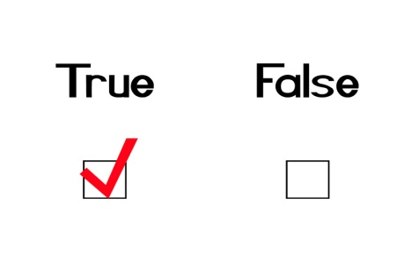
The Truth
Resident Centered Care can actually save your community money:
Reduce weight loss and the use of expensive supplements
Reduce turnover, training and recruiting cost, and overtime
Reduce marketing expenses
Potential increases in census, increasing revenue

Slide 24
The Truth continued
Every community is unique
Each community should customize its efforts to meet and exceed the needs and desires of the residents, staff, and others the organization serves.
It’s not the same for everyone and that’s the point, isn’t it?
No long-term care community is too good a place to live, work, or visit to consider the value of implementing culture change.

Slide 25
More Truths
In many ways a lack of resident or family feedback may be a symptom that the culture in your community actually stifles an open dialogue between residents, families, and staff. Maybe they can’t envision anything besides an institutional environment.
Resident Centered Care is not about a renovation or remodel to our buildings, but a revolution in our culture and our philosophy.
There are many changes that can be made without spending a lot of resources on renovation.
Regulations support Culture Change

Slide 26
What’s the real impact?
A community that truly implements Culture Change encourages staff to remember why they do what they do.
It empowers staff to interact with their residents thereby enabling them to provide the caring support that is needed.
Culture Change empowers residents and direct care staff.
Resident Centered Care affords staff several opportunities to discover a renewed passion for their work.
Don’t we need a renewed passion for our work?

Slide 27

What’s the impact
When residents are given more choices they become less demanding.
The feeling of control that the resident has replaces the need for continuous demands on the staff.
Culture Change actually deters possible litigation by making residents and families comfortable discussing concerns and problems as they arise, rather than waiting until they become disgruntled with the community and it’s management.
Families are less likely to hotline you or complain, if they are empowered to address concerns and are active participants in the decision making.

Slide 28

Let’s talk numbers for a minute.
Our first year of CARES
95% reduction in agency staffing
44% reduction in turnover (29 employees/$430,662)
50% reduction in weight loss
Decrease in Pressure Ulcers by 92%
Decrease in falls by 50%
70% reduction in the use of psychotropic medication
Significant increases in resident and staff satisfaction

Slide 29
What worked, and still does?
Resident Inspired Activities
Increased amount of smaller group activities
Increased utilization of volunteers
Volunteer Activity Cart
Hospice/ Comfort Cart
More food and snack choices implemented
Resident Questionnaire Sheets implemented
Increased schedule adaptations of showers, awake times, room trays, sleep times, etc.
Resident Committees like: Food Committee, Activity Committee, Wellness Committee, Building and Grounds, Welcome Committee, Landscape Committee, IT, Library, Banner, Fundraising, etc.

Slide 30
What worked, and still does?
Regular and consistent staff assignments
Homelike decorating of our common areas
Overhead paging system eliminated, Personal radios implemented
Residents allowed more access to outside areas
Direct care staff involvement in plan of care, Care Rounds
Warmer and more welcoming Move in process (Welcome folder developed by the residents), welcome gift
Learning Circles implemented in meetings
Flexible scheduling implemented for staff
Formal and informal activities led by residents and staff

Slide 31

What worked, and still does?
Outside activities
Grievance tracking Policy & Procedure with timely follow-up
More rewarding staff for positive outcomes, Caught Caring, Stars Cards
Quarterly Culture Change Champions
More Resident lead activities
More Associate lead in-services
Support groups
Men’s and Women’s group
Mentor Program for all position

Slide 32

Person-Centered Care Promotes?
  Personal worth
  Social confidence
  Respect
  Truthfulness
  Independence
  Engagement
  Hope
Notes:
When the person is living their best life it leads to an increase in :

Slide 33
Can Person Centered Care be Used to Benefit our Associates?
Let me ask you a question.

Slide 34
Shouldn’t we take care of the staff as well as we take care of the residents?
Develop a Plan of Care for your employees (Employee Development Plan)
Create Tier Levels for each position to aspire to and build skills (this creates a career path)
Mentor/Peer Buddy for every new employee
Extraordinary Onboarding
Employee Career

Slide 35
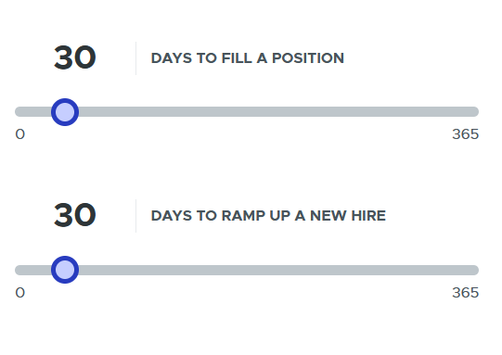
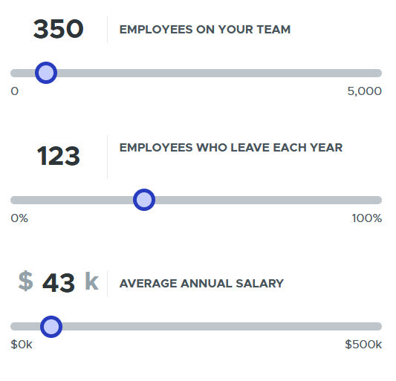
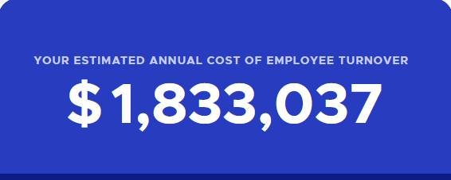
Turnover Cost
If the average turnover is 35% & the average # of employees
is 350, then 123 employees turnover in a year
https://bonus.ly/cost-of-employee-turnover-calculator

Slide 36

How Do We know Resident Centered Care is Working?
Resident and staff satisfaction surveys
Consistently observing and listening
Trying new things
Analyzing how they are working and making changes to individualize care
Positive clinical program outcomes
Notes:
It’s a never-ending journey and evolution, there is no finish, we must constantly get resident feedback and input to be successful in Culture Change
This is an ongoing process which requires constant oversight and guidance by the leadership to assure that compliance is maintained.
Are you asking residents and staff for input on how they rate your community?
What about determining the root cause analysis of the problem?

Slide 37

What everyone needs to know:
Resident Centered Care sometimes requires negotiation.
It’s different for every community
It’s a never-ending journey and evolution, there is no finish, we must constantly get resident feedback and input to be successful in Culture Change.
Residents Centered/Directed Care impacts everything in a positive way when successful, staff retention and satisfaction, resident satisfaction, and most of all Quality Indicators.

Slide 38
Summary Principles of Resident Centered Care
Know each person
Each and every person does make a difference
Relationship is the fundamental building block of a transformed culture
Respond to spirit, as well as mind, and body
Risk taking is a normal part of life
Put person before task
Everyone including elders are entitled to self-determination wherever they live

Slide 39

Staff Values and Goals
Know each person
Relationship is the fundamental building block of a transformed culture
Respond to spirit, as well as mind, and body
All are entitled to self-determination wherever they live

Slide 40
Takeaways
By promoting the growth and development of all, you and your team can experience VICTORY!
By developing Leaders that believe in Person Directed Care you can experience Victory and Growth
By making a positive impact on the lives of the residents and associates we serve, we leave an imprint on their hearts, building loyalty, a family
Person Directed Care can be our Victory and Legacy, for all we serve.
Person Directed Care can make a difference in the lives of the residents and staff, reduce turnover, improve engagement for all

Slide 41

Questions?

Slide 42

The Texas Culture Change Coalition is a non-profit initiative that is dedicated to transforming the culture of long-term care provided to Texans, who are aging or have disabilities, by affirming the dignity and value of each individual and the caregivers who provide support for them.
For More Information and Tools:
WWW.TXCCC.NET

Slide 43
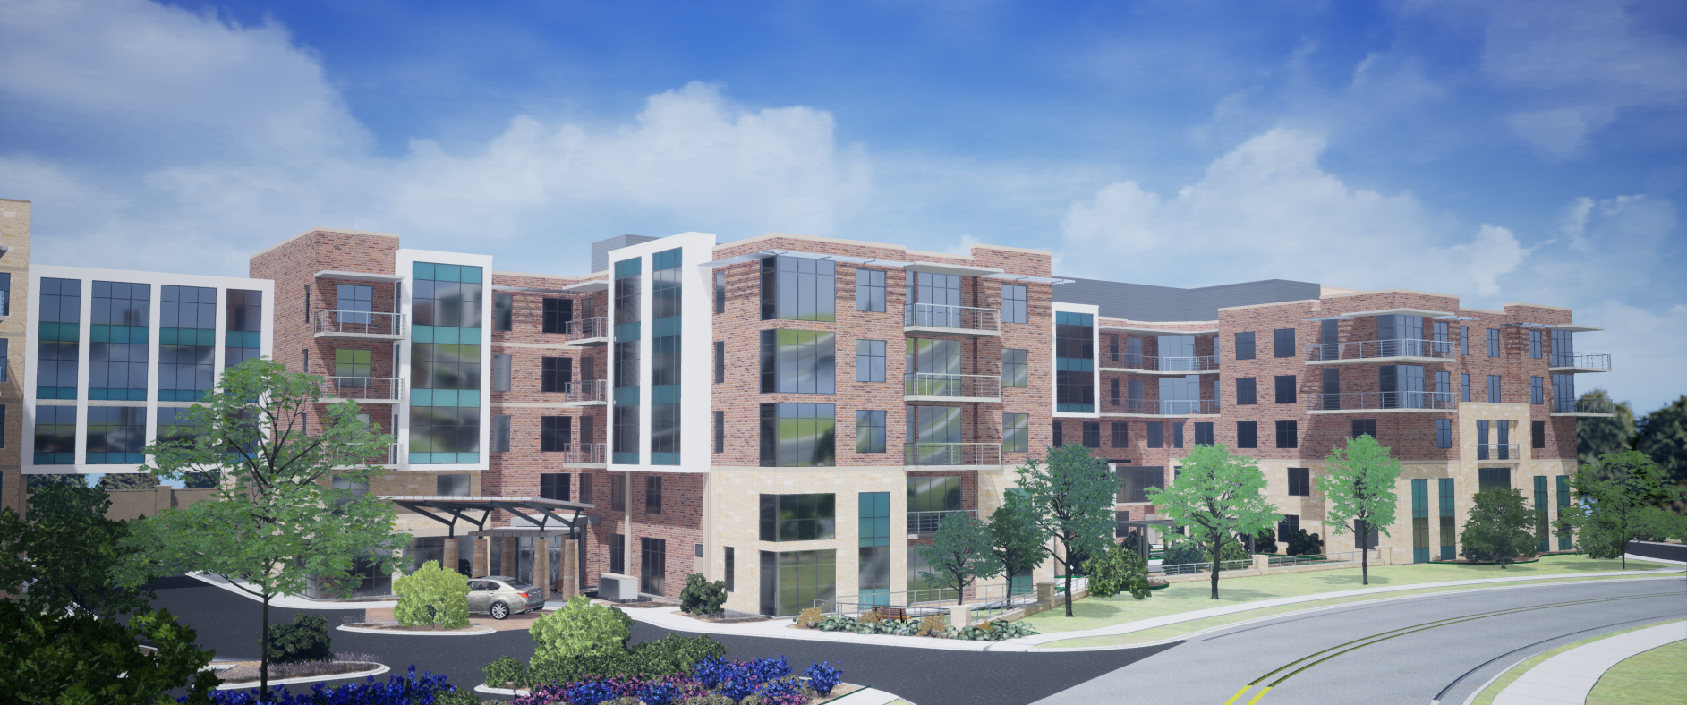
Thank you for attending. Westminster is an extraordinary place to live
and work, and for the best is yet to come.
ADDRESS
PHONE & EMAIL
SOCIAL MEDIA
4100 Jackson Avenue
Austin, TX 78731
info@ westminsteratx.com
512-454-4711

